Slide 1
Forecasting daily A&E attendances in R Andy McCann
MLCSU BI/Urgent and Emergency Care (UEC) Team
Contacts:
Data: andrew.mccann1@nhs.net UEC: seamus.mcgirr1@nhs.net

Slide 2
Requirements and implementation
Develop forecasting method applicable to all daily series, initial focus on A&E attendances and admissions
Beat existing methods, remove arbitrary adjustments, extend time horizon
Implemented in R, which can be integrated with SQL data warehouse
Captures variation due to day of week, Bank Holiday weekends, school holidays, start of term, seasonal variation and any underlying trend
ARIMA structure captures step-changes and short-term dynamics and calculates robust confidence intervals
Model structure able to capture effects of other factors in future, e.g. weather and other repeating events (e.g. football derbies)

Slide 3
Caveats/Concerns
Forecasts are always wrong!
Lots of variability in the series
Danger of ‘spurious precision’
How are the forecasts used in practice? e.g. capacity constraints
Volume of attendances not actually what usually causes A&E problems
Transparency and ‘explainability’ important. Understanding and explaining underlying seasonality (day of week, time of year etc.) probably more important than actual forecasts.
Crucial to evaluate based on forecasts, not on fit, and to compare forecasting performance with existing methods. I have generally fit using data from 2010-2017 and forecast the whole of 2018.

Slide 4
Use of R
I was a newcomer to R (and to forecasting)
R obvious choice to use modern forecasting methods. Actual fitting model only one line of code:
DHRTest <- auto.arima(attendancests, seasonal=FALSE, lambda=0,
xreg=as.matrix(cbind(UseDummy[1:lastactual,],fourier(attendancests, K=KTerms))))
Most code is data ‘wrangling’, creating dummy variables etc.
Also found R (and markdown notebook) useful for charting/visualisations for data discovery (but still used Excel at times!)
R particularly good for batch procedures to evaluate across multiple datasets
I am used to coding, but still challenges around terminology, version changes, etc.

Slide 5

Recommended guide:
otexts.com/fpp2/
Free online book, introduction to forecasting plus practical guide to the use of the R forecast package, by the person who created the package. Regularly updated.

Slide 6
Methods
Existing methodology was average of same weekday of preceding 6 weeks, sometimes manually adjusted, e.g. for Bank Holidays. Actually performs relatively well, though struggles for e.g. start of school holidays.
Averages of equivalent day of previous years captures seasonality better, but struggles with trends and step-changes.
Considered other ‘modern’ methods such as Exponential Smoothing (including Holts-Winters), TBATS, etc. These have advantages, including allowing seasonality to vary and giving more weight to recent observations.
Requirement to include covariates (including dummy variables) meant that a Dynamic Harmonic Regression model with ARIMA errors was obvious choice.

Slide 7
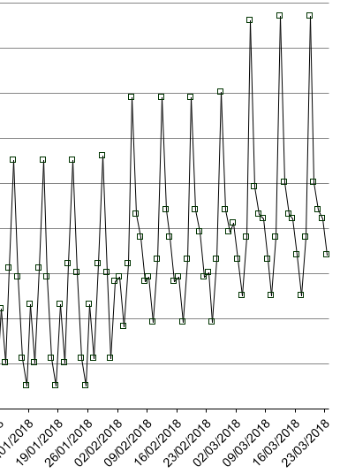
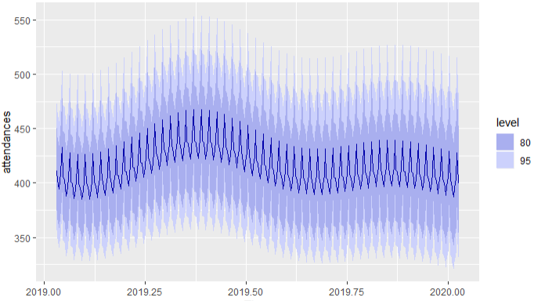
Harmonics - Fourier Terms
Models which have dummy variables for each month of the year give jumps from month to month.
Fourier terms give a smooth seasonal pattern.

Slide 8
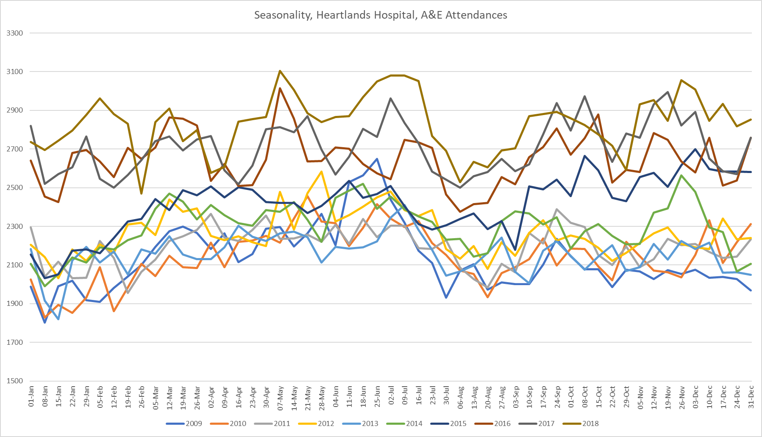
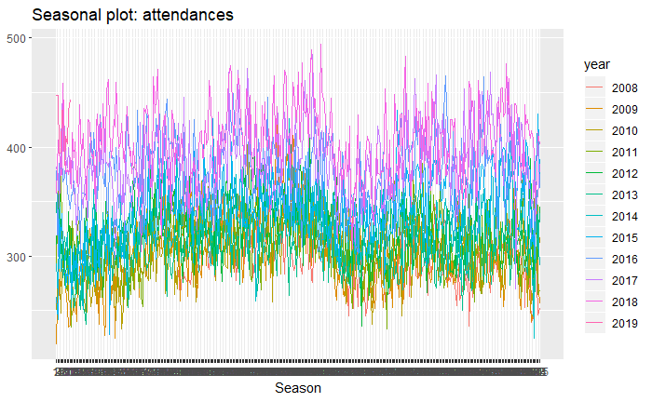
Lots of variability in the data
Mondays not always busiest! Seasonal patterns change, Easter moves, there can be trends and step-changes.
Weekly A&E attendances

Slide 9
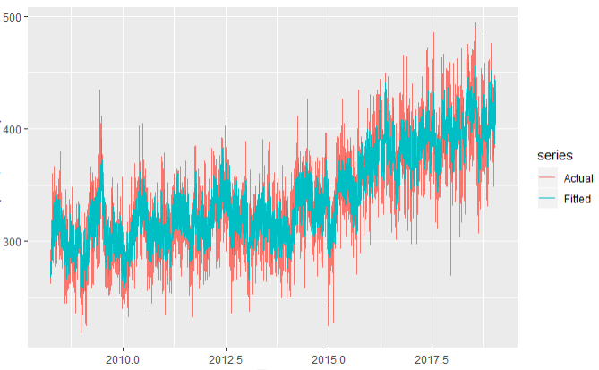
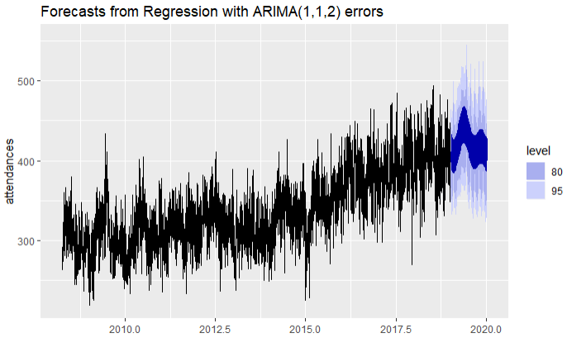
Initial investigation using pure time-series ARIMA models
Basic auto.arima fits quite well (6.1% MAPE) but does not capture seasonality, giving a flat medium-term forecast.
Adding fourier terms for day of week and 2 pairs of terms for time of year seasonality gives a better fit (5.6% MAPE) and more useful forecasts.

Slide 10
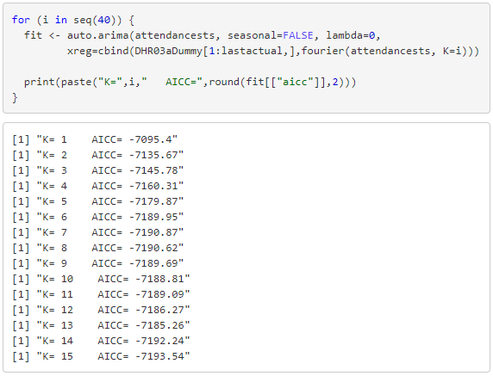
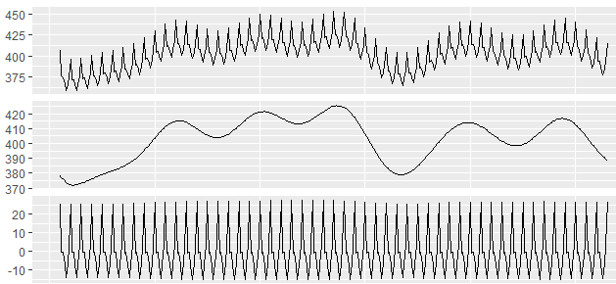
More fourier terms gives a better fit and forecast …
Using a loop in R to select the optimal number of fourier terms leads to a model with 7 pairs of terms, fits better (MAPE 5.5%, AICc -7190.87).

Slide 11
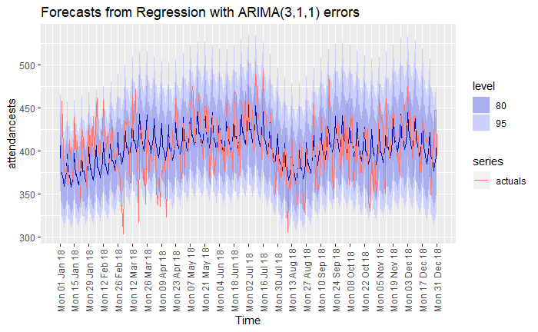
… but hard to explain effect of e.g. school holidays
This forecasts 17% better than the existing method (forecast MAPE of 6.2% vs 7.5%) and appears to be picking up effects such as school holidays.
However, it is hard to explain and will not deal with moveable holidays like Easter.

Slide 12
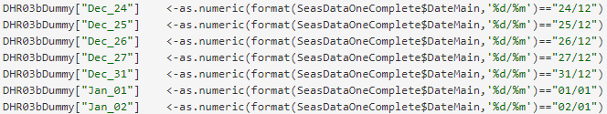
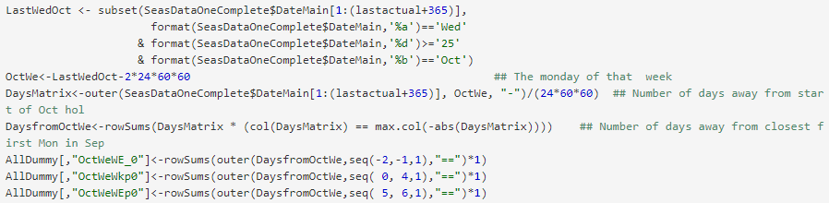
Decided better to create dummies for Bank/School holidays
School holidays started as a list for a region from published websites, but am working to generalise them. E.g. West Midlands October half-term seems to be based on the last Wednesday in October, in other regions it is based on the last Friday in October.

Slide 13
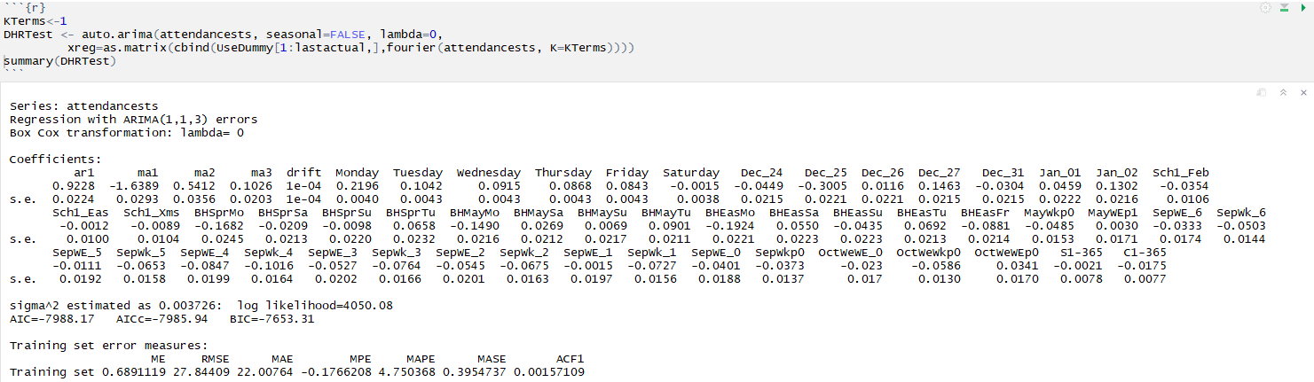
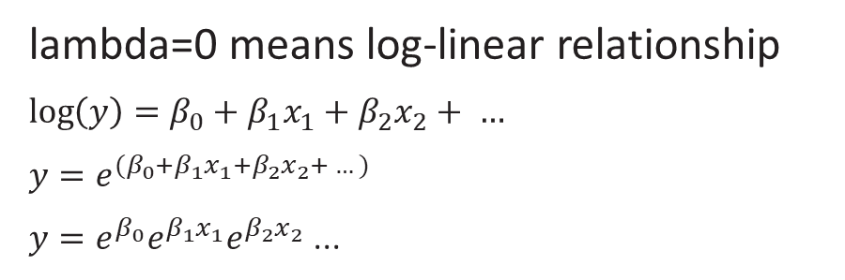
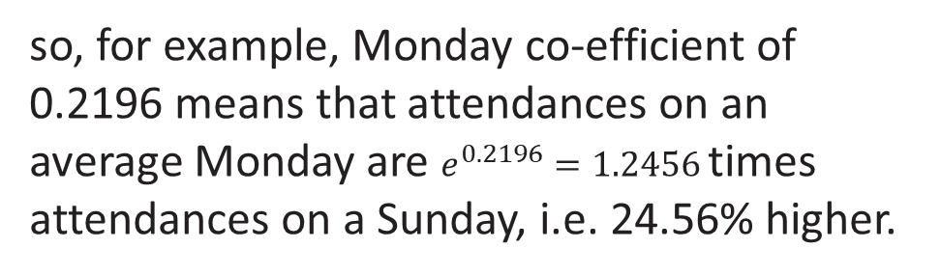
Log-linear relationship means effects are multiplied together
lambda=0 means log-linear relationship
$$\log\left(y\right)=β_{0}+β_{1}x_{1}+β_{2}x_{2}+ …$$
$y=e^{{(β}_{0}+β_{1}x_{1}+β_{2}x_{2}+ …)}$
$y=e^{β_{0}}e^{β_{1}x_{1}}e^{β_{2}x_{2}}$ ...
so, for example, Monday co-efficient of 0.2196 means that attendances on an average Monday are $e^{0.2196}=1.2456$ times attendances on a Sunday, i.e. 24.56% higher.

Slide 14
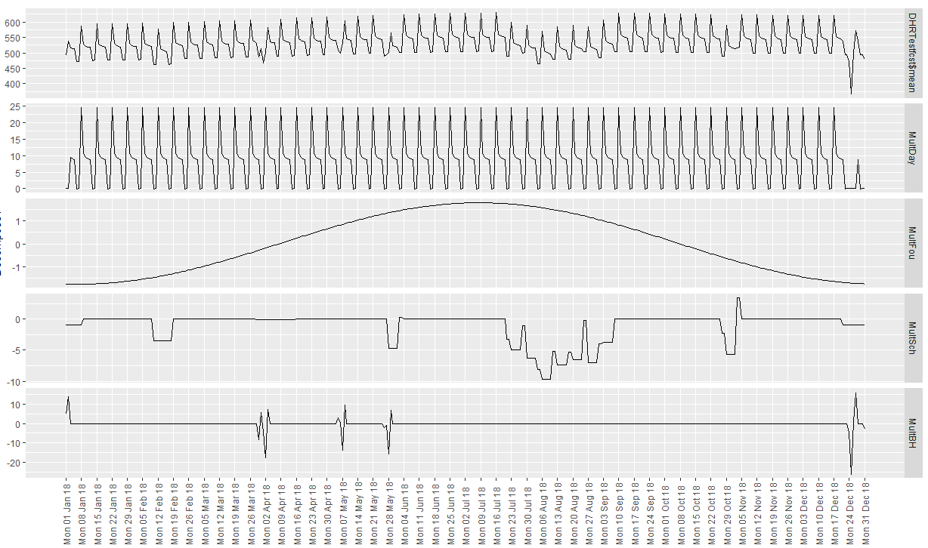
Separate effects of dummy variables and single fourier pair for time of year

Slide 15
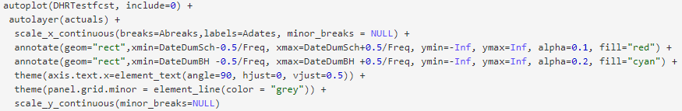
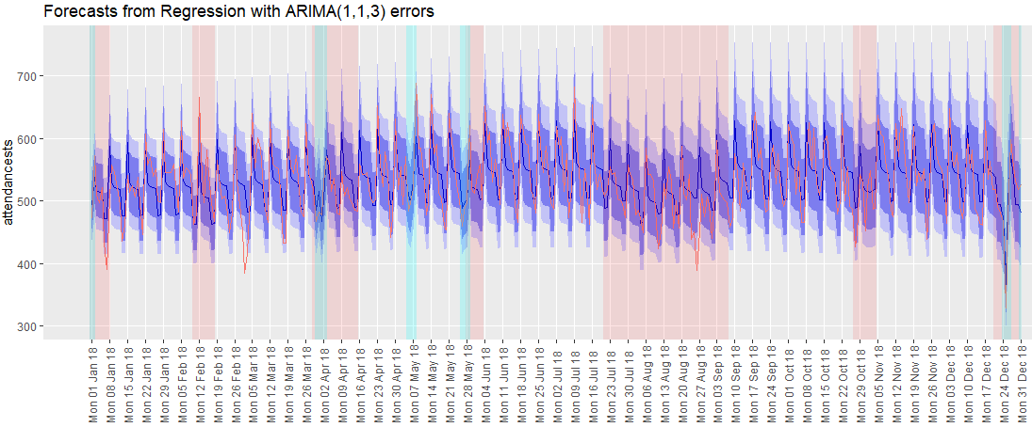
Can use annotate in R to overlay the dummy variables on a chart
Actuals
Forecast
80% Prediction Interval
95% Prediction Interval
School Holidays
Bank Holiday weekends
Notes:
Different hospital to previous examples, but forecast MAPE of this one is 5.3%, compared with the old method’s 6.7%.

Slide 16
Separate R script to run on server and evaluate many forecasts
Calculating 52 weekly forecasts from early 2018 onwards, using the new method outperforms (by a relatively small margin) the existing weekly method for all hospitals apart from 58, where we know that the inclusion of a Walk in Centre affects the data.

Slide 17
Weekly Performance-attendances
There are still some weeks when the existing forecast was closer to the actuals than the new method. E.g. for hospital 74, the existing and the new method each won 50%.

Slide 18
Annual Performance-attendances
The new method allows for longer forecast horizons. Even forecasting the whole of 2018 using only data to end-2017, the new method outperforms the RCMT method for 80% of hospitals, even though the RCMT uses data up to the end of each week.
Note: (Hospital 69 not shown on the chart as the MAPE was very high)

Slide 19
Weekly Performance-admissions/ambulances
Forecast performance for 2018 data is also better for admissions and ambulances for all except Hospital 54

Slide 20
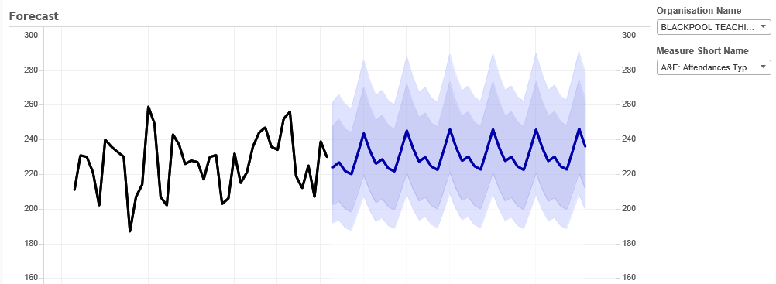
Scheduled R script outputs to DW, can present in e.g. Tableau

Slide 21
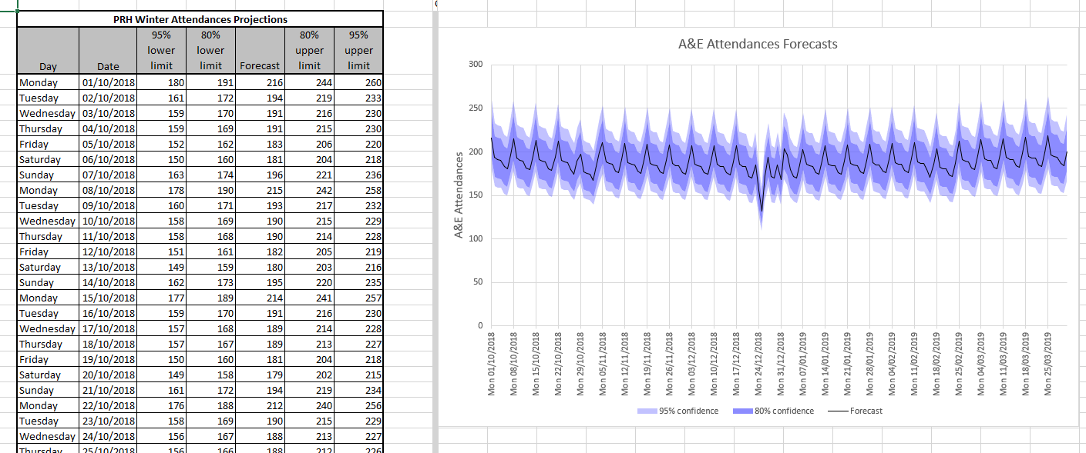
Or in Excel

Slide 22
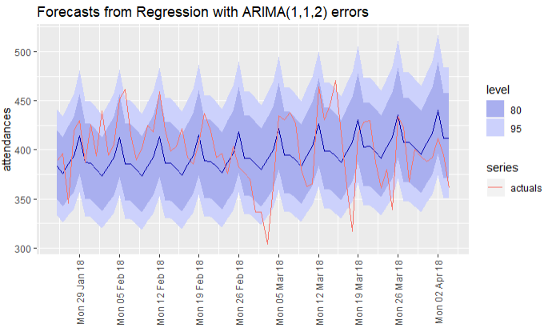
Example 10 week forecast with confidence limits
Example forecast vs actuals
Clear Monday peaks, as expected. For this hospital, Fridays have the lowest attendances (elsewhere, have seen Saturday as lowest)
79% of actuals are within 80% limits and 91% are within 95% limits

Slide 23
Next steps
Generalise school holiday dummies ideally to not need local lists.
Incorporate effects of weather rather than fourier terms for time of year.
Publish results - Any suggestions for which journal?

Slide 24

Any Questions?
Contact me at: andrew.mccann1@nhs.net

